Slide 1
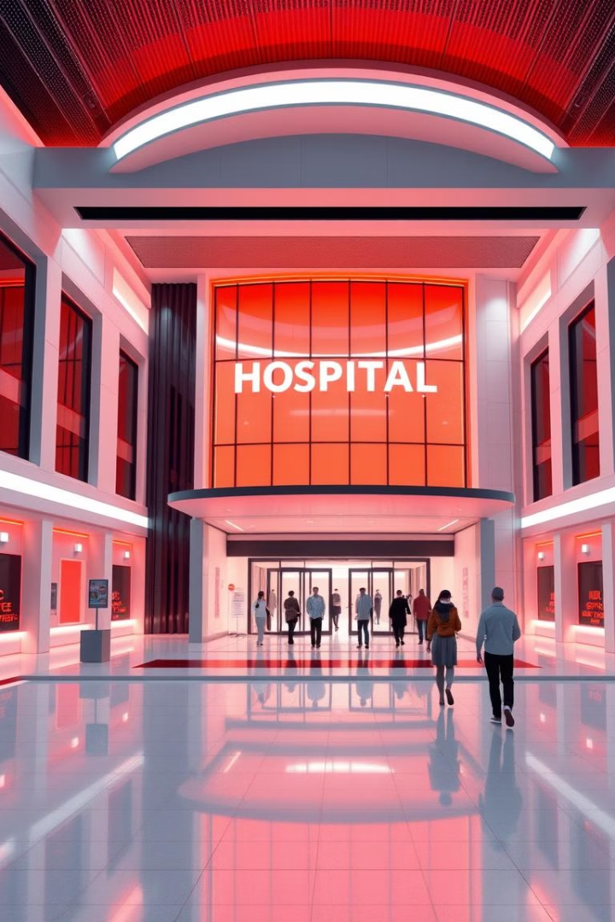
Healthcare Management System: Mini Project
This presentation outlines a mini project focused on developing a user-friendly and efficient healthcare management system.

Slide 2
Introduction
Challenges in Healthcare
Importance of Digital Solutions
Existing healthcare management systems often face challenges like inefficient data storage, slow communication, and poor accessibility.
Digital solutions can improve efficiency, enhance patient care, and provide better access to healthcare information.

Slide 3

Project Objective
1
1. Efficient Patient Record Management
2
2. Real-Time Communication
Our system aims to streamline patient record management, providing a central repository for all healthcare data.
Facilitating real-time communication between healthcare providers and patients, improving coordination and patient satisfaction.

Slide 4
System & Hardware Requirements
Hardware
Software
Modern cloud-capable systems with ample processing power and storage capacity are essential for handling the demands of a healthcare management system.
A combination of technologies including MongoDB, Express.js, React.js, Node.js, cloud services, and Git are employed to ensure a robust and scalable system.

Slide 5
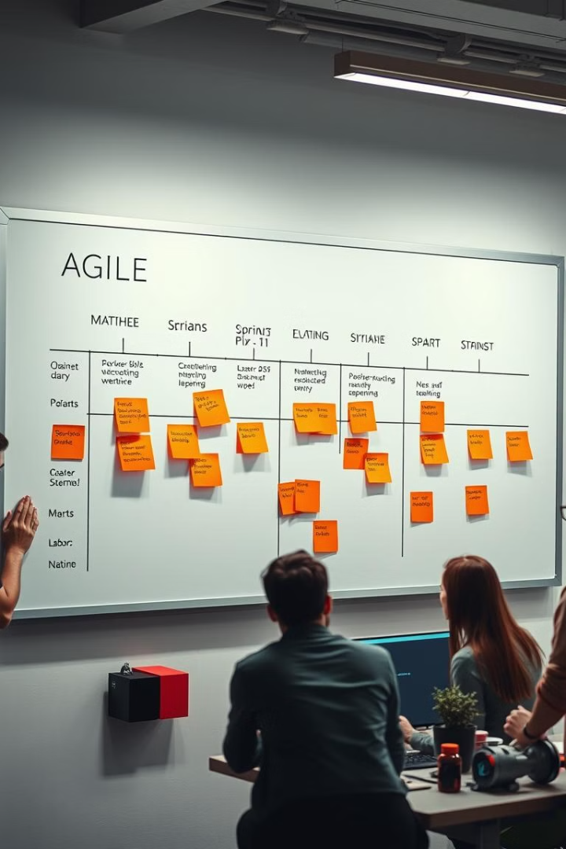
Development Methodology
1
The development process follows the Agile methodology, allowing for flexibility, adaptability, and continuous improvement.
2
Sprint planning and iterations are key components, enabling us to deliver value incrementally and respond to changes quickly.
3
This iterative approach ensures that the system meets the needs of healthcare professionals and patients effectively.

Slide 6

Frontend Technologies
React.js
Responsive UI Design
React.js is used to build a dynamic and interactive user interface, ensuring a smooth and user-friendly experience.
The system's design is responsive, adapting to different screen sizes and devices, making it accessible to all users.

Slide 7



Backend Technologies
Node.js
Express.js
Node.js is employed for building the backend infrastructure and handling server-side logic, ensuring efficient data processing.
Express.js is used to develop RESTful APIs, enabling seamless communication between the frontend and backend of the system.

Slide 8
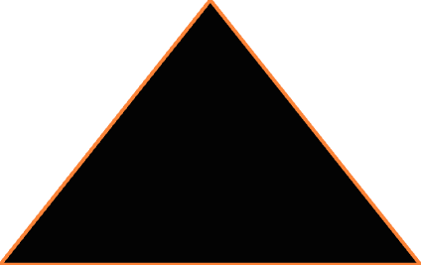

Database Design
MongoDB
1
MongoDB, a NoSQL database, is chosen for its flexibility and scalability, ideal for storing diverse healthcare data.
Data Tables
2
The database structure includes tables for patients, appointments, electronic health records, and other relevant data, ensuring efficient information management.

Slide 9
Security Features
JWT Authentication
1
JSON Web Tokens (JWT) are used for secure authentication, ensuring only authorized users can access the system.
Data Privacy Measures
2
Robust data privacy measures are implemented to safeguard sensitive patient information, complying with industry standards and regulations.

Slide 10
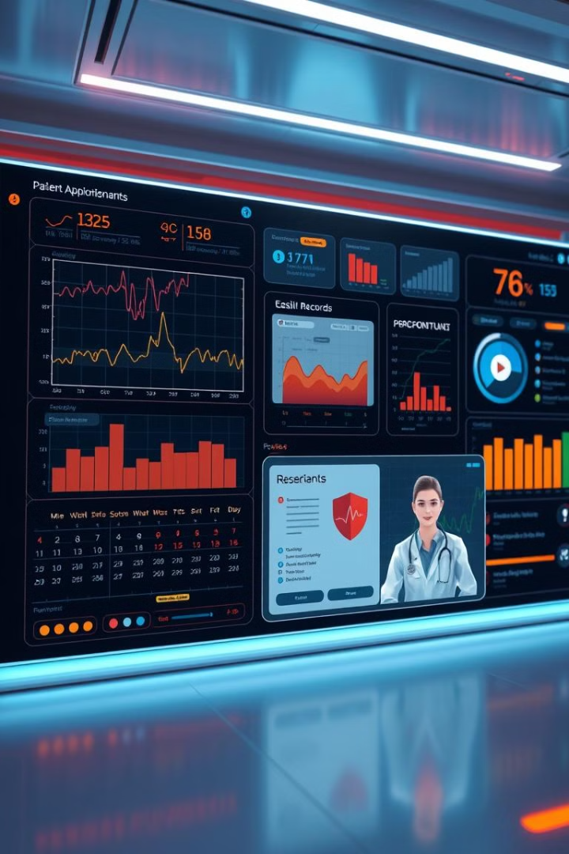
Core Features
1
2
Patient Management
Appointment Scheduling
Efficiently manage patient profiles, including demographic information, medical history, and insurance details.
Streamline appointment scheduling, enabling patients to book appointments online and healthcare providers to manage schedules.
3
4
Electronic Health Records (EHR)
Telemedicine Support
Maintain secure and comprehensive electronic health records, providing a centralized repository for all patient information.
Facilitate virtual consultations and remote patient monitoring, enhancing accessibility and convenience for patients.

